Slide 1

Heart Attack or Myocardial Infarction Detection
CS 699 Data Mining
Osama Muhammad, Sravani Oruganti

Slide 2
Dataset Description
Dataset contains U.S citizens risk behaviors and preventive health practices that could affect their health status.
Our goal is to predict the risk of Heart Attack.
It has 24 variables and 1 target variable and has 401,950 rows of data.
Below are the screen shots of summary and correlation heat map of our dataset.

Slide 3
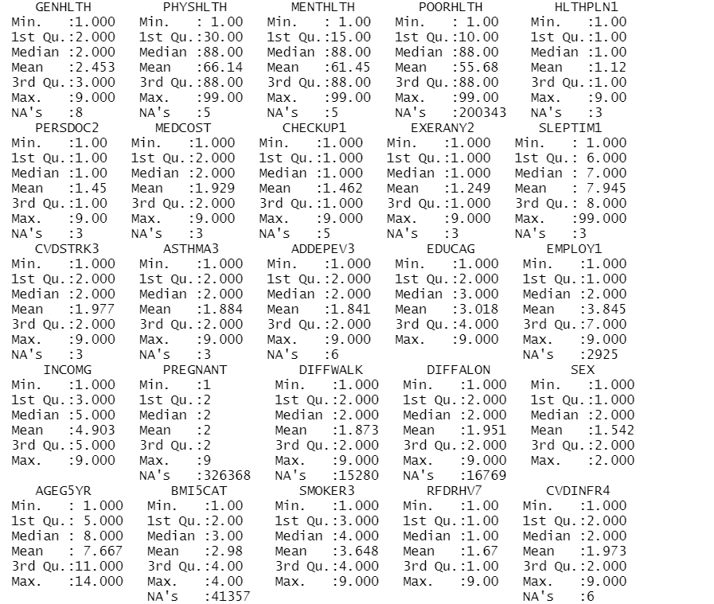

Slide 4
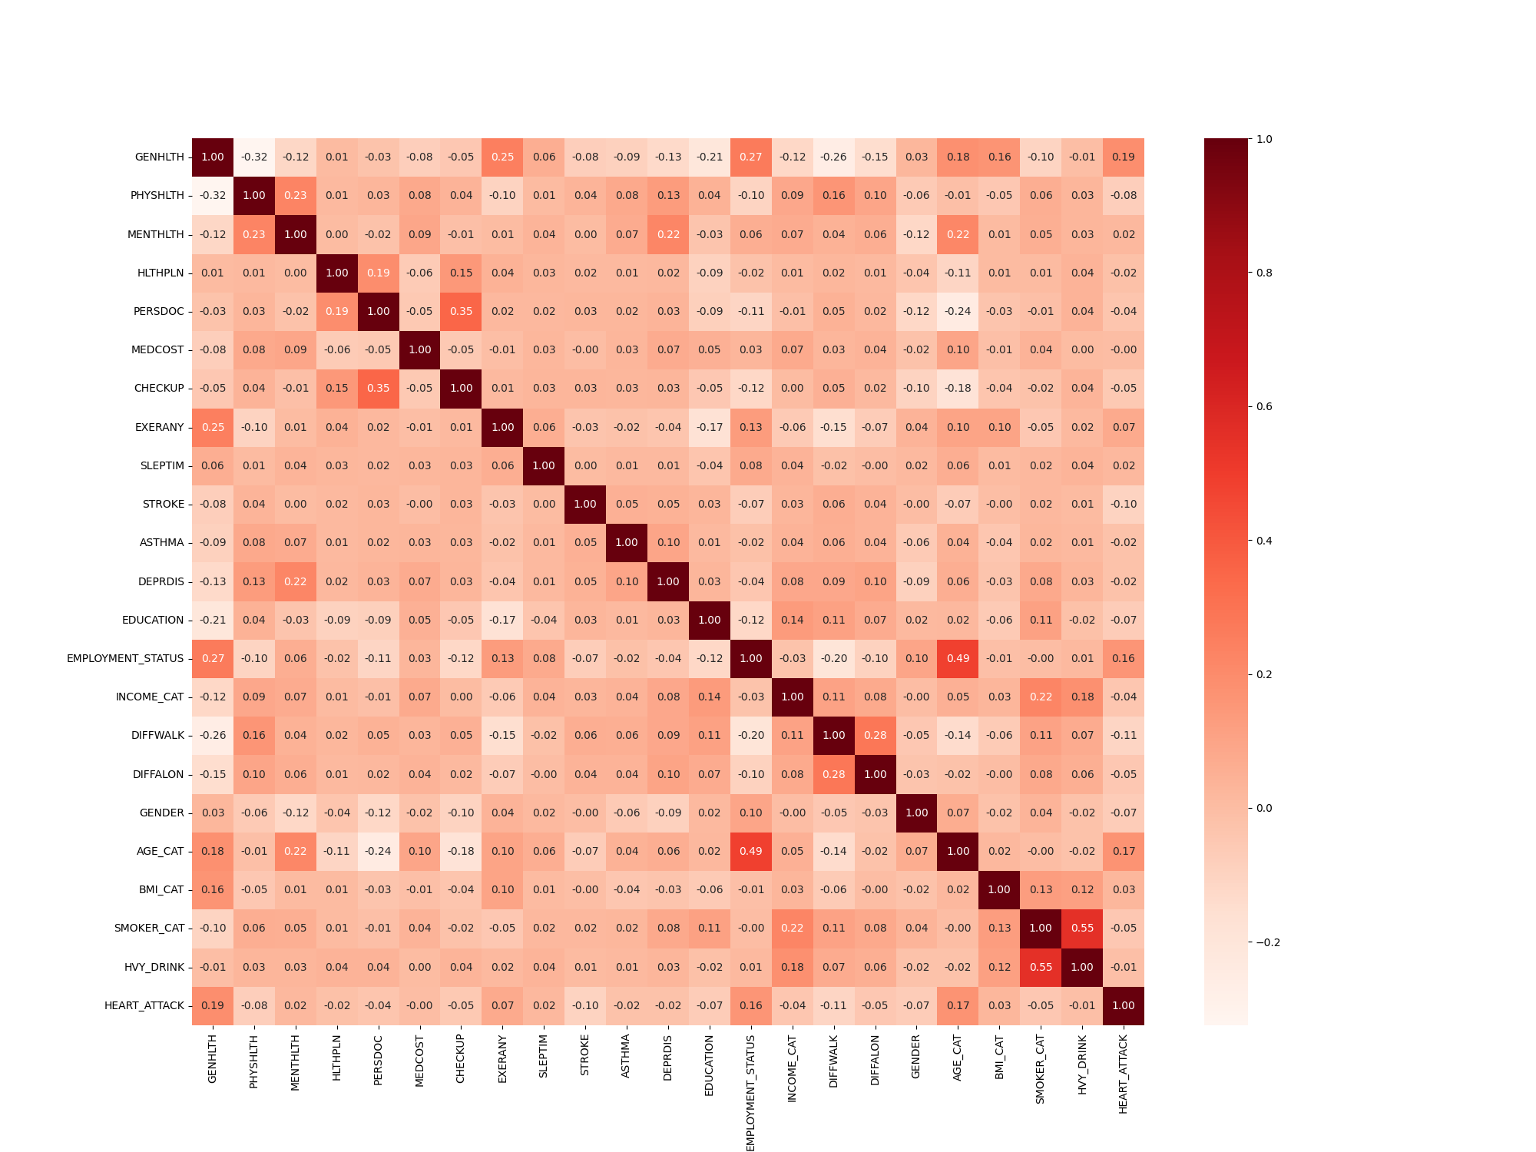

Slide 5
Datamining Tools
R – Used this to clean the data.
Python – Used to balance the dataset, run feature selection techniques and classifier algorithms.
Excel – Used to calculated averages.

Slide 6
Classification Algorithms
Gaussian Naïve Bayes – Type of Naïve Bayes algorithm. Assumes all the features are independent and have Gaussian distribution.
Random Forest – Builds multiple decision trees and does a majority voting to get single prediction.
Logistic Regression – Logistic Regression is a “Supervised machine learning” algorithm that can be used to model the probability of a certain class or event. It is used when the data is linearly separable, and the outcome is binary or dichotomous in nature.
Decision Tree - Splits the feature space based on different criteria like entropy and generates rules based on splits.
Ada Boost – Combined with other classifiers to boost their performance.

Slide 7
Attribute selection methods
F-score – Scores each of the features individually.
Recursive Feature Elimination - Eliminates the weakest features until the specified number of features are reached.
Select From Model – Uses a classifier to calculate the importance of a feature.
Sequential Feature Selection - Improves computational efficiency and reduce the generalization error by removing the irrelevant features or noise.
Correlation Based Feature Selection - Correlation refers to how close two variables are and when two features have high correlation, one feature among them is dropped.

Slide 8
Balancing Methods
SMOTE
Borderline SMOTE

Slide 9
Attributes selected by different methods
Balancing Method | Classifier | Features Selected
Borderline SMOTE | Correlation Based Feature Selection | STROKE', 'EXERANY', 'EDUCATION', 'CHECKUP', ‘ PHYSHLTH', 'GENDER', 'DIFFWALK', 'EMPLOYMENT_STATUS', 'GENHLTH', 'AGE_CAT'
 | F Score Feature Selection | GENHLTH', 'PHYSHLTH', 'CHECKUP', 'EXERANY', 'STROKE', 'EDUCATION', 'EMPLOYMENT_STATUS', 'DIFFWALK', 'GENDER', 'AGE_CAT'
 | Forward Sequential Feature Selection | GENHLTH', 'PERSDOC', 'CHECKUP', 'STROKE', 'EDUCATION', 'EMPLOYMENT_STATUS', 'GENDER', 'AGE_CAT', 'SMOKER_CAT', 'HVY_DRINK'
 | Recursive Feature Elimination | GENHLTH', 'PERSDOC', 'CHECKUP', 'STROKE', 'ASTHMA', 'EDUCATION', 'DIFFWALK', 'GENDER', 'AGE_CAT', 'SMOKER_CAT'
 | Select From Model Feature Selection | GENHLTH', 'PHYSHLTH', 'EXERANY', 'SLEPTIM', 'STROKE', 'EDUCATION', 'INCOME_CAT', 'GENDER', 'AGE_CAT', 'SMOKER_CAT'

Slide 10
Attributes selected by different methods
Balancing Method | Classifier | Features Selected
SMOTE | Correlation Based Feature Selection | EXERANY', 'EDUCATION', 'GENDER', 'STROKE', 'CHECKUP', 'PHYSHLTH', 'DIFFWALK', 'EMPLOYMENT_STATUS', 'GENHLTH', 'AGE_CAT'
 | F Score Feature Selection | GENHLTH', 'PHYSHLTH', 'CHECKUP', 'EXERANY', 'STROKE', 'EDUCATION', 'EMPLOYMENT_STATUS', 'DIFFWALK', 'GENDER', 'AGE_CAT'
 | Forward Sequential Feature Selection | GENHLTH', 'HLTHPLN', 'PERSDOC', 'CHECKUP', 'STROKE', 'EDUCATION', 'GENDER', 'AGE_CAT', 'BMI_CAT', 'SMOKER_CAT'
 | Recursive Feature Elimination | GENHLTH', 'PERSDOC', 'MEDCOST', 'CHECKUP', 'STROKE', 'ASTHMA', 'DEPRDIS', 'EDUCATION', 'DIFFWALK', 'AGE_CAT'
 | Select From Model Feature Selection | GENHLTH', 'PHYSHLTH', 'EXERANY', 'SLEPTIM', 'STROKE', 'EDUCATION', 'INCOME_CAT', 'GENDER', 'AGE_CAT', 'SMOKER_CAT'

Slide 11
Data Mining Procedure
Data Preparation – Used Tidy verse library in R to clean the data.
Balancing the dataset and feature selection – Balanced the training dataset using smote techniques and ran each of the feature selection techniques in python.
Machine learning – Ran each of the classifier algorithms on the features selected on training dataset and unbalanced testing dataset.

Slide 12
Machine Learning Algorithms
Ada Boost with Logistic Regression
Decision Tree
Logistic Regression
Gaussian Naïve Bayesian
Random Forest

Slide 13
Ada Boost with Logistic Regression – Borderline SMOTE
Feature Selection | Class | Accuracy | TPR | FPR | Precision | Recall | F1 Score | MCC | ROC
Correlation based feature selection | Heart Attack = 1 | 0.943644361 | 0.998132171 | 0.001867829 | 0.945299146 | 0.998132171 | 0.970997406 | 0.01382565 | 0.512735356
 | Heart Attack = 2 | 0.943644361 | 0.004583292 | 0.995416708 | 0.125296482 | 0.004583292 | 0.008839774 | 0.01382565 | 0.512735356
 | Weighted | 0.943644361 | 0.943644361 | 0.056355639 | 0.900326299 | 0.943644361 | 0.918231565 | 0.01382565 | 0.512735356
F Score feature selection | Heart Attack = 1 | 0.941989438 | 0.996269284 | 0.003730716 | 0.945303092 | 0.996269284 | 0.970117092 | 0.010193589 | 0.57751485
 | Heart Attack = 2 | 0.941989438 | 0.006521094 | 0.993478906 | 0.091946692 | 0.006521094 | 0.012177457 | 0.010193589 | 0.57751485
 | Weighted | 0.941989438 | 0.941989438 | 0.058010562 | 0.898502344 | 0.941989438 | 0.917581872 | 0.010193589 | 0.57751485
Forward Sequential Feature Selection | Heart Attack = 1 | 0.942549905 | 0.996795631 | 0.003204369 | 0.945390942 | 0.996795631 | 0.970411522 | 0.016775978 | 0.653372377
 | Heart Attack = 2 | 0.942549905 | 0.007678544 | 0.992321456 | 0.129027063 | 0.007678544 | 0.014134905 | 0.016775978 | 0.653372377
 | Weighted | 0.942549905 | 0.942549905 | 0.057450095 | 0.900620089 | 0.942549905 | 0.917966984 | 0.016775978 | 0.653372377
Recursive Feature Elimination | Heart Attack = 1 | 0.941318643 | 0.995303511 | 0.004696489 | 0.945487607 | 0.995303511 | 0.969751133 | 0.022000973 | 0.639595686
 | Heart Attack = 2 | 0.941318643 | 0.011036088 | 0.988963912 | 0.144768779 | 0.011036088 | 0.019508946 | 0.022000973 | 0.639595686
 | Weighted | 0.941318643 | 0.941318643 | 0.058681357 | 0.901598677 | 0.941318643 | 0.917631732 | 0.022000973 | 0.639595686
Select from Model | Heart Attack = 1 | 0.910297298 | 0.955370616 | 0.044629384 | 0.950100717 | 0.955370616 | 0.952437056 | 0.090141901 | 0.699211019
 | Heart Attack = 2 | 0.910297298 | 0.133029812 | 0.866970188 | 0.151948227 | 0.133029812 | 0.126473479 | 0.090141901 | 0.699211019
 | Weighted | 0.910297298 | 0.910297298 | 0.089702702 | 0.906328444 | 0.910297298 | 0.907152289 | 0.090141901 | 0.699211019

Slide 14
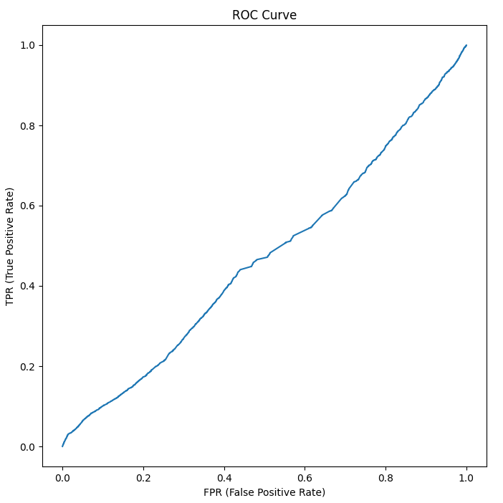
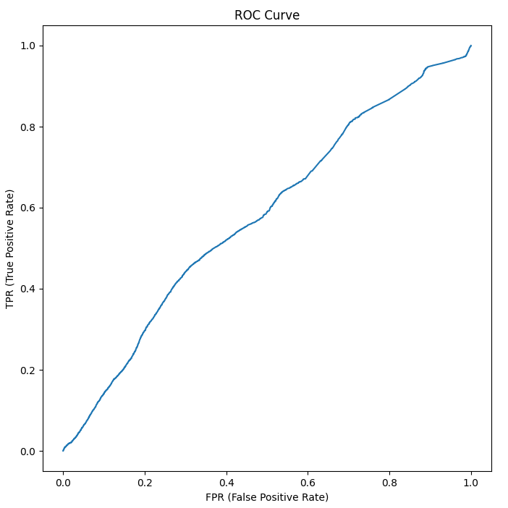
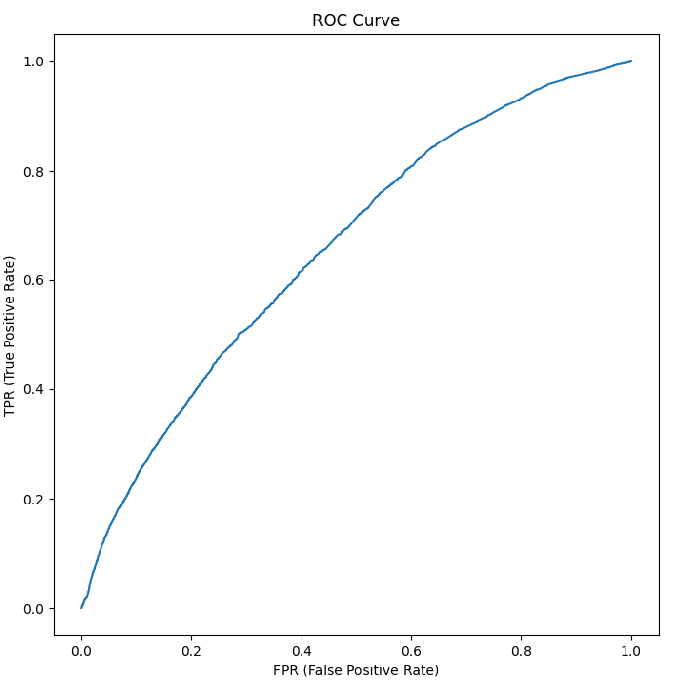
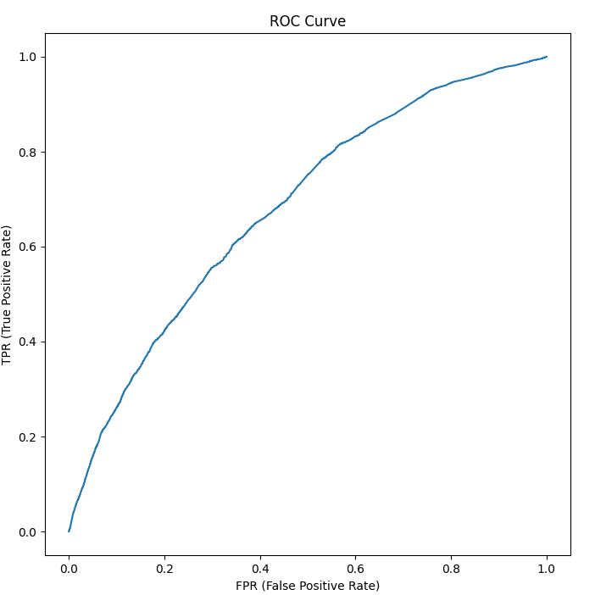
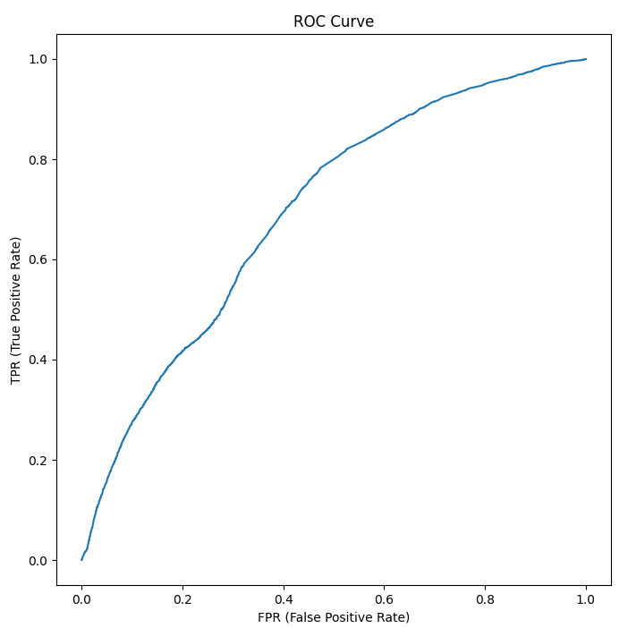
Correlation Based Feature Selection
F Score Feature Selection
Forward Sequential Feature Selection
Recursive Feature Selection
Select from Model Feature Selection

Slide 15
Decision Tree – Borderline SMOTE
Feature Selection | Class | Accuracy | TPR | FPR | Precision | Recall | F1 Score | MCC | ROC
Correlation based feature selection | Heart Attack = 1 | 0.368472617 | 0.348251467 | 0.651748533 | 0.942249441 | 0.348251467 | 0.46053387 | 0.021764693 | 0.530846926
 | Heart Attack = 2 | 0.368472617 | 0.713680245 | 0.286319755 | 0.060409347 | 0.713680245 | 0.110564444 | 0.021764693 | 0.530846926
 | Weighted | 0.368472617 | 0.368472617 | 0.631527383 | 0.893896239 | 0.368472617 | 0.44145991 | 0.021764693 | 0.530846926
F Score feature selection | Heart Attack = 1 | 0.610020742 | 0.627077794 | 0.372922206 | 0.937958858 | 0.627077794 | 0.743691443 | -0.027591147 | 0.470803203
 | Heart Attack = 2 | 0.610020742 | 0.313790602 | 0.686209398 | 0.049192303 | 0.313790602 | 0.084235987 | -0.027591147 | 0.470803203
 | Weighted | 0.610020742 | 0.610020742 | 0.389979258 | 0.889220582 | 0.610020742 | 0.707593075 | -0.027591147 | 0.470803203
Forward Sequential Feature Selection | Heart Attack = 1 | 0.680352756 | 0.704337489 | 0.295662511 | 0.94164905 | 0.704337489 | 0.796269083 | -0.007632153 | 0.486413521
 | Heart Attack = 2 | 0.680352756 | 0.268458523 | 0.731541477 | 0.058852476 | 0.268458523 | 0.090271269 | -0.007632153 | 0.486413521
 | Weighted | 0.680352756 | 0.680352756 | 0.319647244 | 0.89324416 | 0.680352756 | 0.757524885 | -0.007632153 | 0.486413521
Recursive Feature Elimination | Heart Attack = 1 | 0.526452287 | 0.527989715 | 0.472010285 | 0.945780352 | 0.527989715 | 0.667219014 | 0.013359905 | 0.51312783
 | Heart Attack = 2 | 0.526452287 | 0.498337831 | 0.501662169 | 0.060990579 | 0.498337831 | 0.107606474 | 0.013359905 | 0.51312783
 | Weighted | 0.526452287 | 0.526452287 | 0.473547713 | 0.897257369 | 0.526452287 | 0.63658044 | 0.013359905 | 0.51312783
Select from Model | Heart Attack = 1 | 0.640587534 | 0.652842971 | 0.347157029 | 0.951157354 | 0.652842971 | 0.771315026 | 0.041820438 | 0.541617839
 | Heart Attack = 2 | 0.640587534 | 0.430152752 | 0.569847248 | 0.069925432 | 0.430152752 | 0.11964779 | 0.041820438 | 0.541617839
 | Weighted | 0.640587534 | 0.640587534 | 0.359412466 | 0.90282836 | 0.640587534 | 0.73556036 | 0.041820438 | 0.541617839

Slide 16
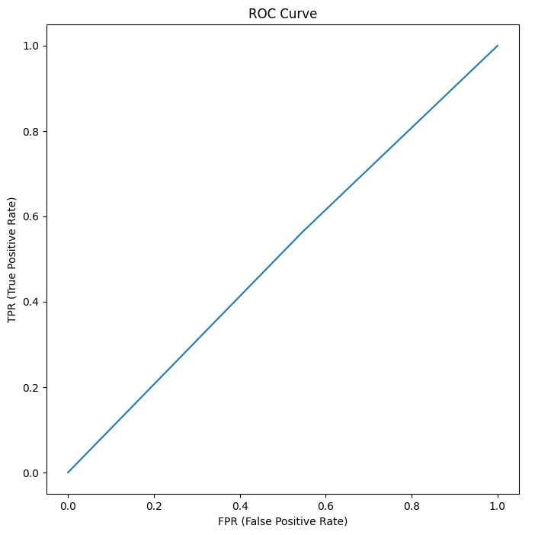
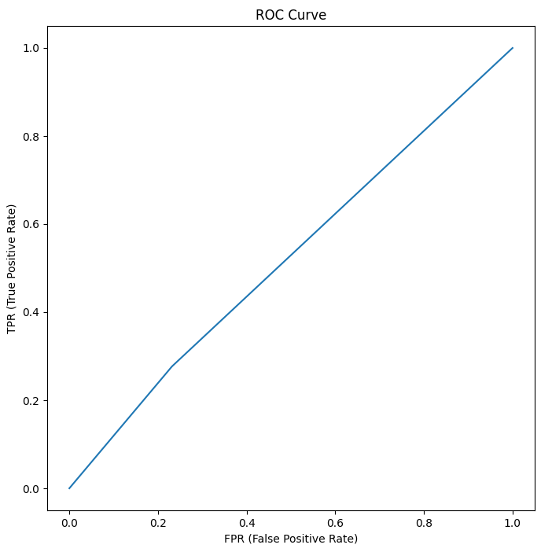
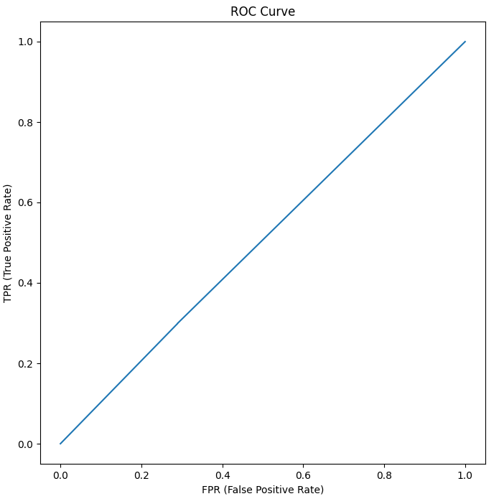
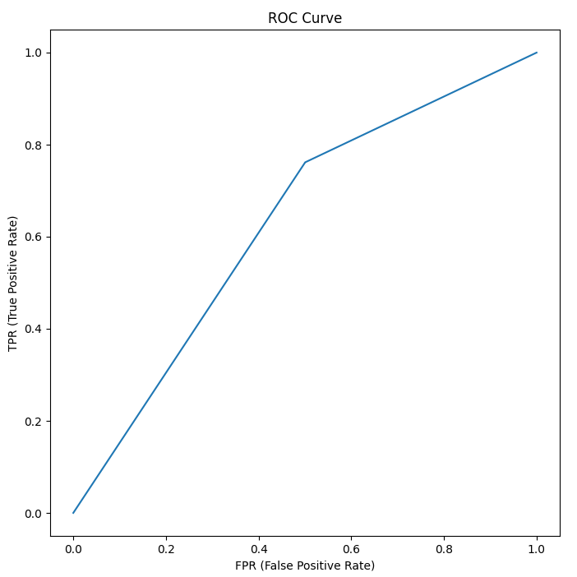
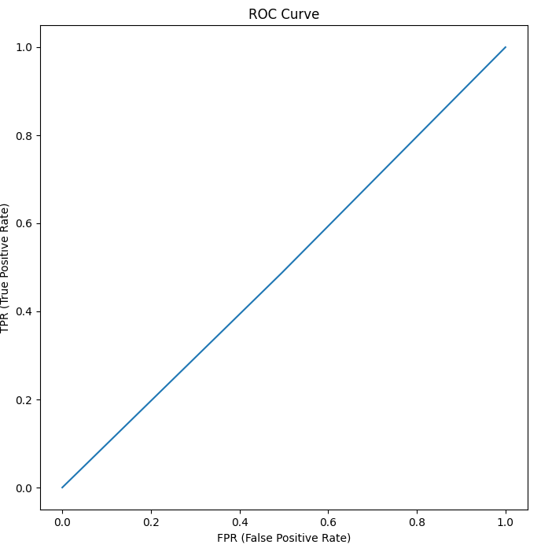
Correlation Based Feature Selection
F Score Feature Selection
Forward Sequential Feature Selection
Recursive Feature Selection
Select from Model Feature Selection

Slide 17
Logistic Regression – Borderline SMOTE
Feature Selection | Class | Accuracy | TPR | FPR | Precision | Recall | F1 Score | MCC | ROC
Correlation based feature selection | Heart Attack = 1 | 0.93962253 | 0.993566294 | 0.006433706 | 0.945339286 | 0.993566294 | 0.968852836 | 0.00945789 | 0.389521608
 | Heart Attack = 2 | 0.93962253 | 0.009889616 | 0.990110384 | 0.080841391 | 0.009889616 | 0.017544069 | 0.00945789 | 0.389521608
 | Weighted | 0.93962253 | 0.93962253 | 0.06037747 | 0.897932099 | 0.93962253 | 0.916685141 | 0.00945789 | 0.389521608
F Score feature selection | Heart Attack = 1 | 0.940818488 | 0.994228711 | 0.005771289 | 0.945917731 | 0.994228711 | 0.969471512 | 0.040896709 | 0.619528511
 | Heart Attack = 2 | 0.940818488 | 0.020331557 | 0.979668443 | 0.169298485 | 0.020331557 | 0.036262895 | 0.040896709 | 0.619528511
 | Weighted | 0.940818488 | 0.940818488 | 0.059181512 | 0.903325357 | 0.940818488 | 0.918292963 | 0.040896709 | 0.619528511
Forward Sequential Feature Selection | Heart Attack = 1 | 0.938725195 | 0.991176266 | 0.008823734 | 0.94651709 | 0.991176266 | 0.968330086 | 0.058188162 | 0.659068422
 | Heart Attack = 2 | 0.938725195 | 0.034735477 | 0.965264523 | 0.186567093 | 0.034735477 | 0.057973982 | 0.058188162 | 0.659068422
 | Weighted | 0.938725195 | 0.938725195 | 0.061274805 | 0.904839791 | 0.938725195 | 0.918406879 | 0.058188162 | 0.659068422
Recursive Feature Elimination | Heart Attack = 1 | 0.938391268 | 0.990967618 | 0.009032382 | 0.946374602 | 0.990967618 | 0.968157631 | 0.052314496 | 0.65337832
 | Heart Attack = 2 | 0.938391268 | 0.032245039 | 0.967754961 | 0.171954622 | 0.032245039 | 0.054204339 | 0.052314496 | 0.65337832
 | Weighted | 0.938391268 | 0.938391268 | 0.061608732 | 0.903903064 | 0.938391268 | 0.918036988 | 0.052314496 | 0.65337832
Select from Model | Heart Attack = 1 | 0.9199238 | 0.96464528 | 0.03535472 | 0.951317313 | 0.96464528 | 0.95792908 | 0.129149269 | 0.731736896
 | Heart Attack = 2 | 0.9199238 | 0.149063378 | 0.850936622 | 0.195817836 | 0.149063378 | 0.168717102 | 0.129149269 | 0.731736896
 | Weighted | 0.9199238 | 0.9199238 | 0.0800762 | 0.909888 | 0.9199238 | 0.914652965 | 0.129149269 | 0.731736896

Slide 18


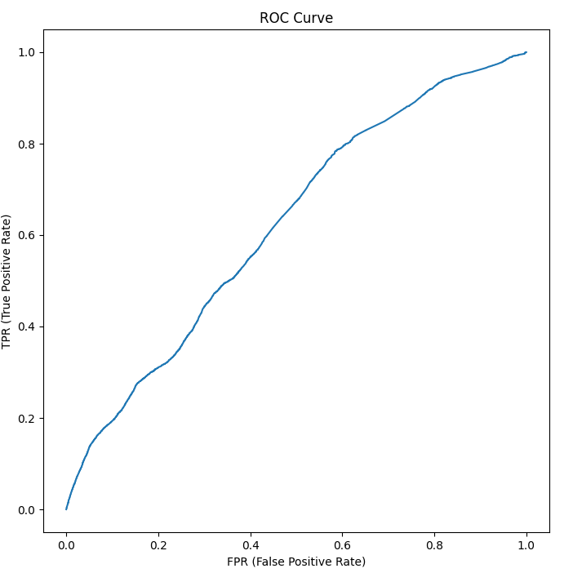
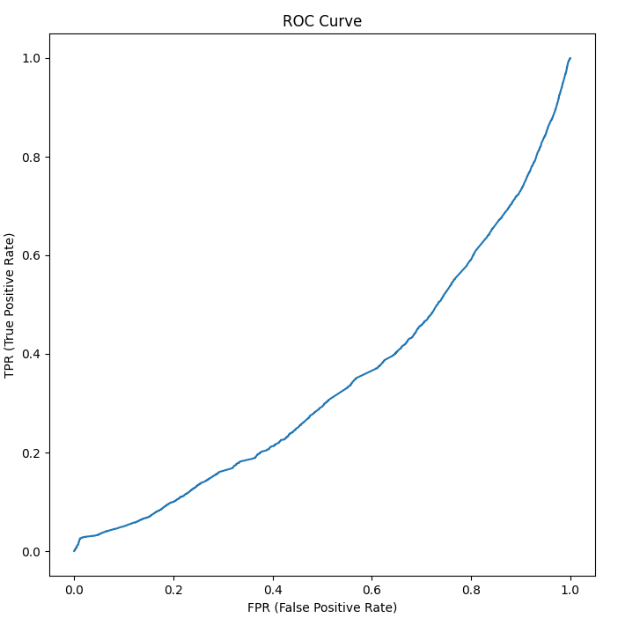
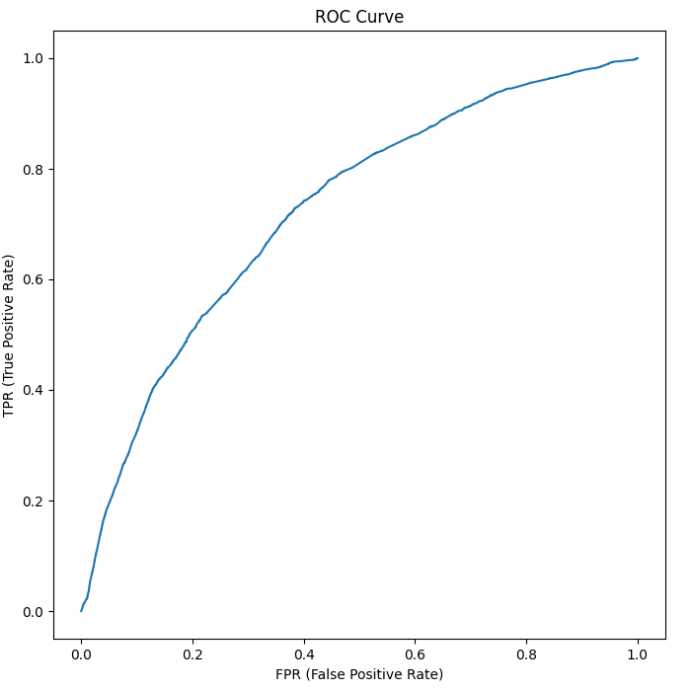
Correlation Based Feature Selection
F Score Feature Selection
Forward Sequential Feature Selection
Recursive Feature Selection
Select from Model Feature Selection

Slide 19
Gaussian Naïve Bayesian – Borderline SMOTE
Feature Selection | Class | Accuracy | TPR | FPR | Precision | Recall | F1 Score | MCC | ROC
Correlation based feature selection | Heart Attack = 1 | 0.51676253 | 0.509793769 | 0.490206231 | 0.963158641 | 0.509793769 | 0.642735997 | 0.069862471 | 0.632093558
 | Heart Attack = 2 | 0.51676253 | 0.631766939 | 0.368233061 | 0.071393146 | 0.631766939 | 0.126100009 | 0.069862471 | 0.632093558
 | Weighted | 0.51676253 | 0.51676253 | 0.48323747 | 0.914243024 | 0.51676253 | 0.614523307 | 0.069862471 | 0.632093558
F Score feature selection | Heart Attack = 1 | 0.935856662 | 0.989450341 | 0.010549659 | 0.945244413 | 0.989450341 | 0.966842238 | 0.00364669 | 0.490675735
 | Heart Attack = 2 | 0.935856662 | 0.012194868 | 0.987805132 | 0.062843518 | 0.012194868 | 0.020416392 | 0.00364669 | 0.490675735
 | Weighted | 0.935856662 | 0.935856662 | 0.064143338 | 0.896853737 | 0.935856662 | 0.914939725 | 0.00364669 | 0.490675735
Forward Sequential Feature Selection | Heart Attack = 1 | 0.937830801 | 0.99161649 | 0.00838351 | 0.945287658 | 0.99161649 | 0.967892173 | 0.005213157 | 0.597317896
 | Heart Attack = 2 | 0.937830801 | 0.010835585 | 0.989164415 | 0.067050468 | 0.010835585 | 0.017908071 | 0.005213157 | 0.597317896
 | Weighted | 0.937830801 | 0.937830801 | 0.062169199 | 0.897127403 | 0.937830801 | 0.915796238 | 0.005213157 | 0.597317896
Recursive Feature Elimination | Heart Attack = 1 | 0.924314862 | 0.97614705 | 0.02385295 | 0.945528203 | 0.97614705 | 0.960575299 | 0.011313978 | 0.596688478
 | Heart Attack = 2 | 0.924314862 | 0.030832348 | 0.969167652 | 0.073616947 | 0.030832348 | 0.042016894 | 0.011313978 | 0.596688478
 | Weighted | 0.924314862 | 0.924314862 | 0.075685138 | 0.897706531 | 0.924314862 | 0.910207336 | 0.011313978 | 0.596688478
Select from Model | Heart Attack = 1 | 0.924314862 | 0.97614705 | 0.02385295 | 0.945528203 | 0.97614705 | 0.960575299 | 0.011313978 | 0.596688478
 | Heart Attack = 2 | 0.924314862 | 0.030832348 | 0.969167652 | 0.073616947 | 0.030832348 | 0.042016894 | 0.011313978 | 0.596688478
 | Weighted | 0.924314862 | 0.924314862 | 0.075685138 | 0.897706531 | 0.924314862 | 0.910207336 | 0.011313978 | 0.596688478

Slide 20
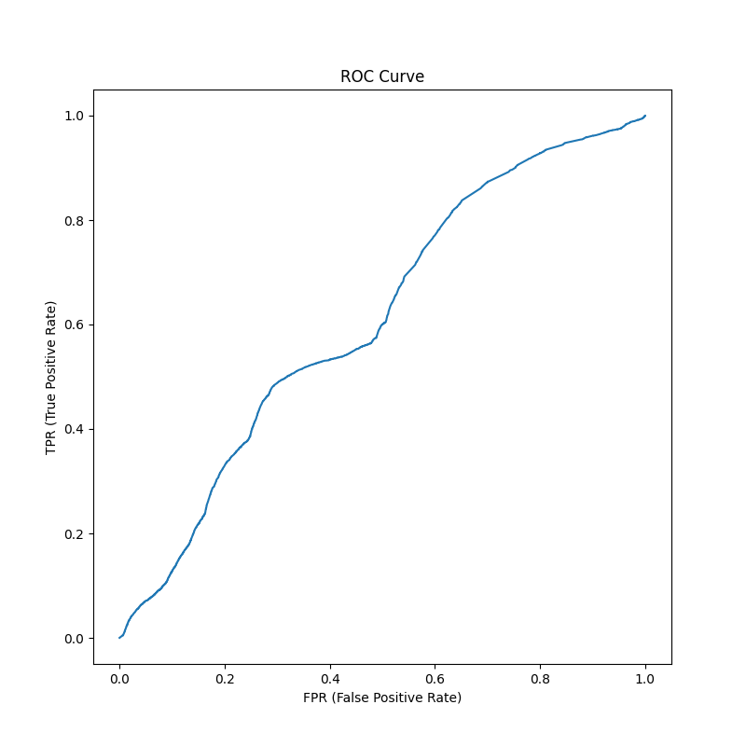
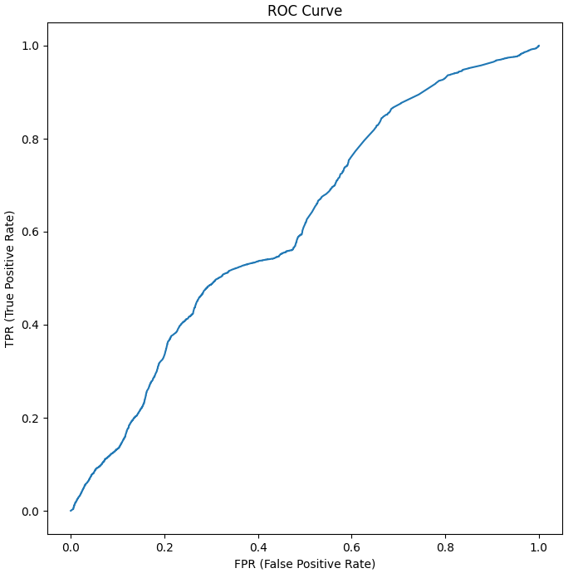
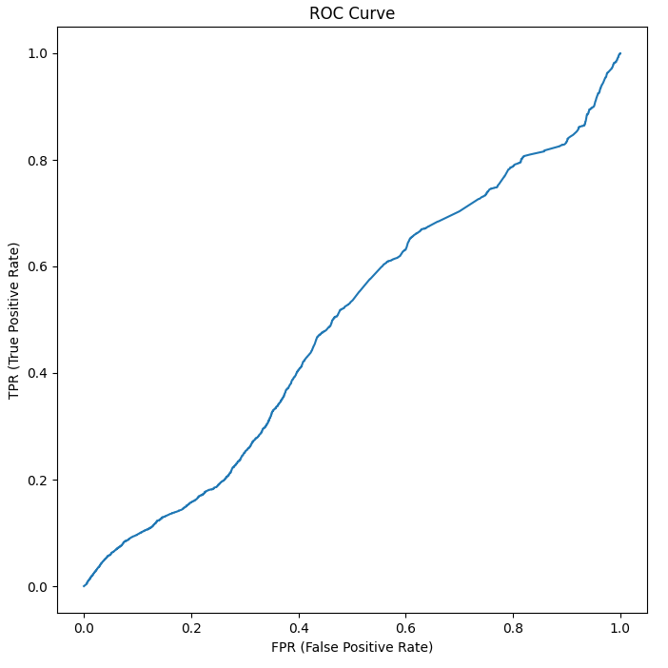
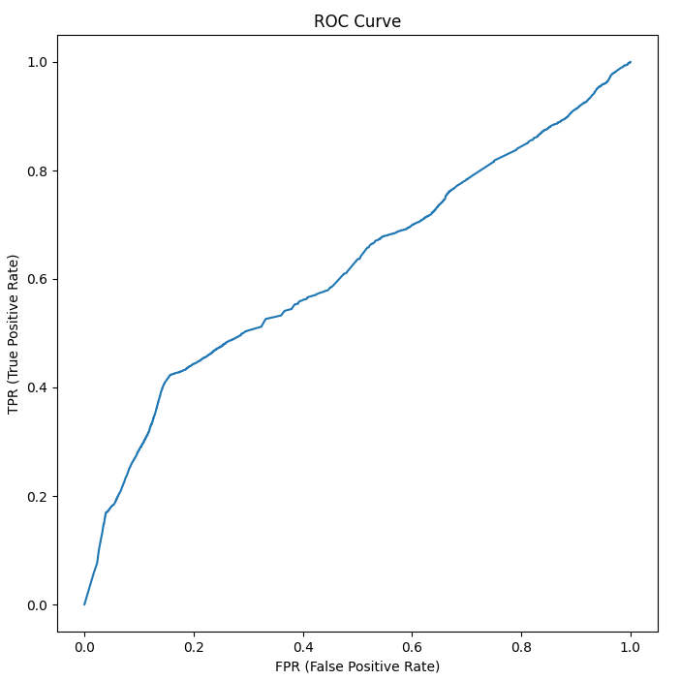
Correlation Based Feature Selection
F Score Feature Selection
Forward Sequential Feature Selection
Recursive Feature Selection
Select from Model Feature Selection

Slide 21
Random Forest – Borderline SMOTE
Feature Selection | Class | Accuracy | TPR | FPR | Precision | Recall | F1 Score | MCC | ROC
Correlation based feature selection | Heart Attack = 1 | 0.797455096 | 0.837469496 | 0.162530504 | 0.94167275 | 0.837469496 | 0.88590295 | -0.034908929 | 0.432081655
 | Heart Attack = 2 | 0.797455096 | 0.106761219 | 0.893238781 | 0.036199842 | 0.106761219 | 0.053260208 | -0.034908929 | 0.432081655
 | Weighted | 0.797455096 | 0.797455096 | 0.202544904 | 0.892018454 | 0.797455096 | 0.840263844 | -0.034908929 | 0.432081655
F Score feature selection | Heart Attack = 1 | 0.845005075 | 0.887896961 | 0.112103039 | 0.94471569 | 0.887896961 | 0.912795619 | -0.004409428 | 0.485727929
 | Heart Attack = 2 | 0.845005075 | 0.105202035 | 0.894797965 | 0.052386576 | 0.105202035 | 0.061438169 | -0.004409428 | 0.485727929
 | Weighted | 0.845005075 | 0.845005075 | 0.154994925 | 0.895782493 | 0.845005075 | 0.866118095 | -0.004409428 | 0.485727929
Forward Sequential Feature Selection | Heart Attack = 1 | 0.836158225 | 0.87502868 | 0.12497132 | 0.94769769 | 0.87502868 | 0.908232402 | 0.029514606 | 0.563582495
 | Heart Attack = 2 | 0.836158225 | 0.166104822 | 0.833895178 | 0.074772597 | 0.166104822 | 0.096205604 | 0.029514606 | 0.563582495
 | Weighted | 0.836158225 | 0.836158225 | 0.163841775 | 0.899831739 | 0.836158225 | 0.863705443 | 0.029514606 | 0.563582495
Recursive Feature Elimination | Heart Attack = 1 | 0.828903044 | 0.867023518 | 0.132976482 | 0.947415603 | 0.867023518 | 0.904710287 | 0.028490227 | 0.563454276
 | Heart Attack = 2 | 0.828903044 | 0.171358739 | 0.828641261 | 0.07418109 | 0.171358739 | 0.100373258 | 0.028490227 | 0.563454276
 | Weighted | 0.828903044 | 0.828903044 | 0.171096956 | 0.899519985 | 0.828903044 | 0.860606181 | 0.028490227 | 0.563454276
Select from Model | Heart Attack = 1 | 0.777178246 | 0.803290358 | 0.196709642 | 0.953902596 | 0.803290358 | 0.871608275 | 0.071393258 | 0.600906931
 | Heart Attack = 2 | 0.777178246 | 0.326892863 | 0.673107137 | 0.085376017 | 0.326892863 | 0.134642127 | 0.071393258 | 0.600906931
 | Weighted | 0.777178246 | 0.777178246 | 0.222821754 | 0.906272322 | 0.777178246 | 0.831197088 | 0.071393258 | 0.600906931

Slide 22
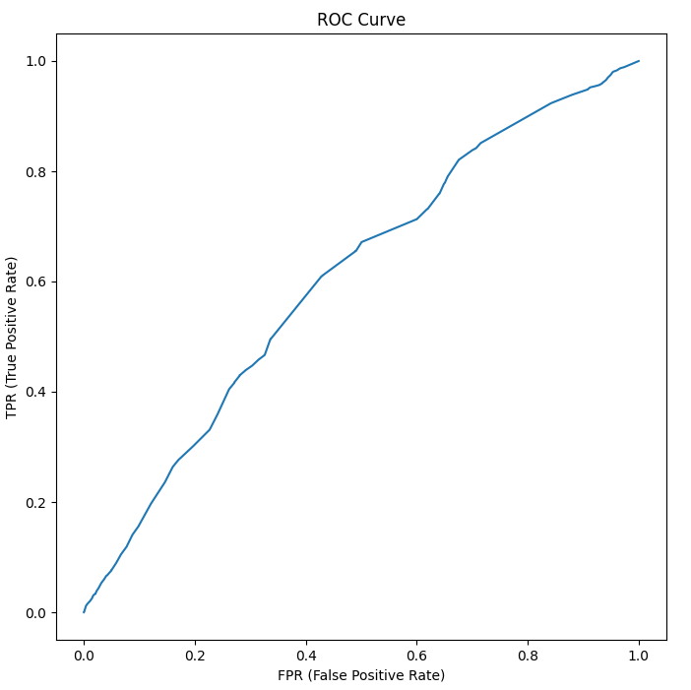
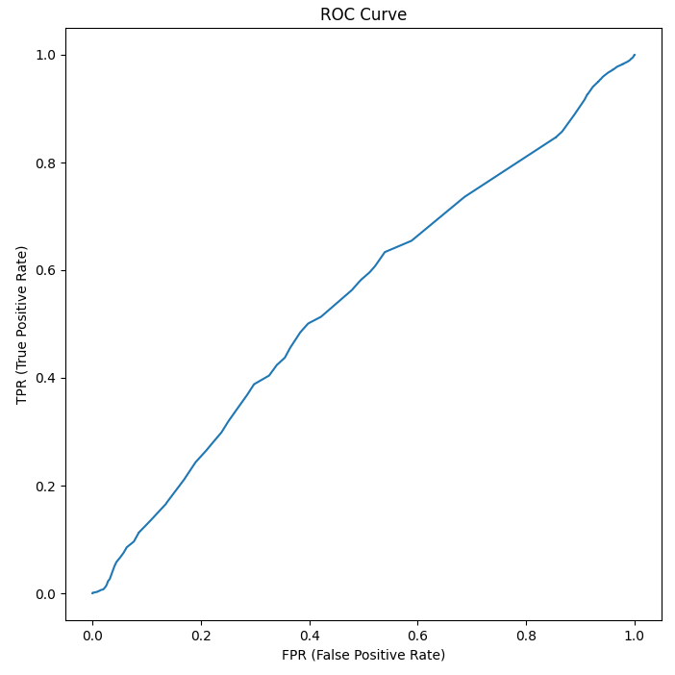
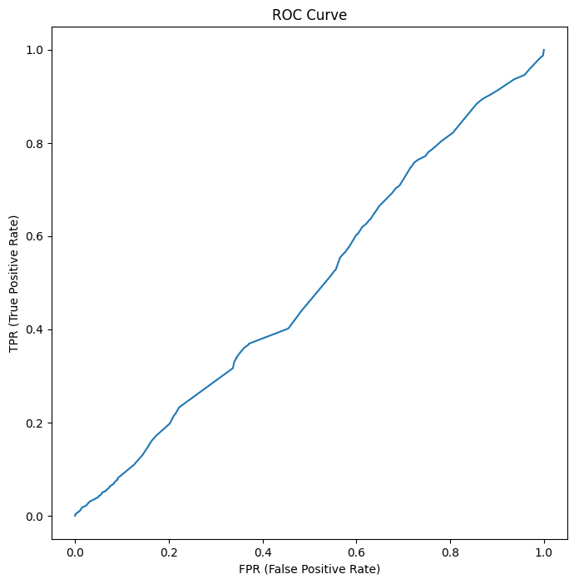
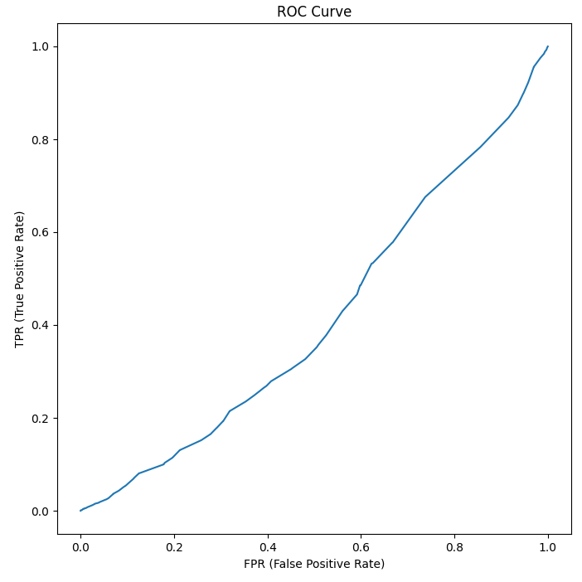
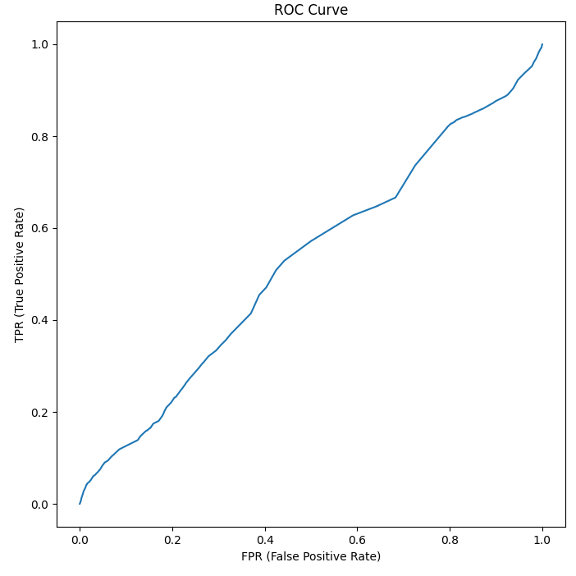
Correlation Based Feature Selection
F Score Feature Selection
Forward Sequential Feature Selection
Recursive Feature Selection
Select from Model Feature Selection

Slide 23
Best Model – Borderline SMOTE
Classifier | Feature Selection | Class | Accuracy | TPR | FPR | Precision | Recall | F1 Score | MCC | ROC
Ada Boost | Recursive Feature Elimination | Heart Attack = 1 | 0.941318643 | 0.995303511 | 0.004696489 | 0.945487607 | 0.995303511 | 0.969751133 | 0.022000973 | 0.639595686
 |  | Heart Attack = 2 | 0.941318643 | 0.011036088 | 0.988963912 | 0.144768779 | 0.011036088 | 0.019508946 | 0.022000973 | 0.639595686
 |  | Weighted | 0.941318643 | 0.941318643 | 0.058681357 | 0.901598677 | 0.941318643 | 0.917631732 | 0.022000973 | 0.639595686
Decision Tree | Select from Model | Heart Attack = 1 | 0.640587534 | 0.652842971 | 0.347157029 | 0.951157354 | 0.652842971 | 0.771315026 | 0.041820438 | 0.541617839
 |  | Heart Attack = 2 | 0.640587534 | 0.430152752 | 0.569847248 | 0.069925432 | 0.430152752 | 0.11964779 | 0.041820438 | 0.541617839
 |  | Weighted | 0.640587534 | 0.640587534 | 0.359412466 | 0.90282836 | 0.640587534 | 0.73556036 | 0.041820438 | 0.541617839
Logistic Regression | Select from Model | Heart Attack = 1 | 0.9199238 | 0.96464528 | 0.03535472 | 0.951317313 | 0.96464528 | 0.95792908 | 0.129149269 | 0.731736896
 |  | Heart Attack = 2 | 0.9199238 | 0.149063378 | 0.850936622 | 0.195817836 | 0.149063378 | 0.168717102 | 0.129149269 | 0.731736896
 |  | Weighted | 0.9199238 | 0.9199238 | 0.0800762 | 0.909888 | 0.9199238 | 0.914652965 | 0.129149269 | 0.731736896
Gaussian Naïve Bayesian | Recursive Feature Elimination | Heart Attack = 1 | 0.924314862 | 0.97614705 | 0.02385295 | 0.945528203 | 0.97614705 | 0.960575299 | 0.011313978 | 0.596688478
 |  | Heart Attack = 2 | 0.924314862 | 0.030832348 | 0.969167652 | 0.073616947 | 0.030832348 | 0.042016894 | 0.011313978 | 0.596688478
 |  | Weighted | 0.924314862 | 0.924314862 | 0.075685138 | 0.897706531 | 0.924314862 | 0.910207336 | 0.011313978 | 0.596688478
Random Forest | Select from Model | Heart Attack = 1 | 0.777178246 | 0.803290358 | 0.196709642 | 0.953902596 | 0.803290358 | 0.871608275 | 0.071393258 | 0.600906931
 |  | Heart Attack = 2 | 0.777178246 | 0.326892863 | 0.673107137 | 0.085376017 | 0.326892863 | 0.134642127 | 0.071393258 | 0.600906931
 |  | Weighted | 0.777178246 | 0.777178246 | 0.222821754 | 0.906272322 | 0.777178246 | 0.831197088 | 0.071393258 | 0.600906931

Slide 24
Ada Boost with Logistic Regression – SMOTE
Feature Selection | Class | Accuracy | TPR | FPR | Precision | Recall | F1 Score | MCC | ROC
Correlation based feature selection | Heart Attack = 1 | 0.943895909 | 0.998404437 | 0.001595563 | 0.94530761 | 0.998404437 | 0.971130645 | 0.015895248 | 0.583381099
 | Heart Attack = 2 | 0.943895909 | 0.004478198 | 0.995521802 | 0.144906683 | 0.004478198 | 0.008656026 | 0.015895248 | 0.583381099
 | Weighted | 0.943895909 | 0.943895909 | 0.056104091 | 0.901396561 | 0.943895909 | 0.918347218 | 0.015895248 | 0.583381099
F Score feature selection | Heart Attack = 1 | 0.941849689 | 0.996071584 | 0.003928416 | 0.945337477 | 0.996071584 | 0.970041476 | 0.012266354 | 0.579878388
 | Heart Attack = 2 | 0.941849689 | 0.007379195 | 0.992620805 | 0.098273264 | 0.007379195 | 0.013726906 | 0.012266354 | 0.579878388
 | Weighted | 0.941849689 | 0.941849689 | 0.058150311 | 0.898881302 | 0.941849689 | 0.917595413 | 0.012266354 | 0.579878388
Forward Sequential Feature Selection | Heart Attack = 1 | 0.942333662 | 0.996614509 | 0.003385491 | 0.945340977 | 0.996614509 | 0.970296033 | 0.01313136 | 0.700430025
 | Heart Attack = 2 | 0.942333662 | 0.006907136 | 0.993092864 | 0.116275926 | 0.006907136 | 0.012183363 | 0.01313136 | 0.700430025
 | Weighted | 0.942333662 | 0.942333662 | 0.057666338 | 0.899878271 | 0.942333662 | 0.917747393 | 0.01313136 | 0.700430025
Recursive Feature Elimination | Heart Attack = 1 | 0.943954751 | 0.998365781 | 0.001634219 | 0.945396378 | 0.998365781 | 0.97115917 | 0.024017229 | 0.631823228
 | Heart Attack = 2 | 0.943954751 | 0.006225691 | 0.993774309 | 0.18033645 | 0.006225691 | 0.012034592 | 0.024017229 | 0.631823228
 | Weighted | 0.943954751 | 0.943954751 | 0.056045249 | 0.903438401 | 0.943954751 | 0.918558979 | 0.024017229 | 0.631823228
Select from Model | Heart Attack = 1 | 0.915259124 | 0.961845377 | 0.038154623 | 0.949270616 | 0.961845377 | 0.955267138 | 0.076989577 | 0.702672513
 | Heart Attack = 2 | 0.915259124 | 0.112024146 | 0.887975854 | 0.141530531 | 0.112024146 | 0.109501674 | 0.076989577 | 0.702672513
 | Weighted | 0.915259124 | 0.915259124 | 0.084740876 | 0.904972904 | 0.915259124 | 0.908893848 | 0.076989577 | 0.702672513

Slide 25
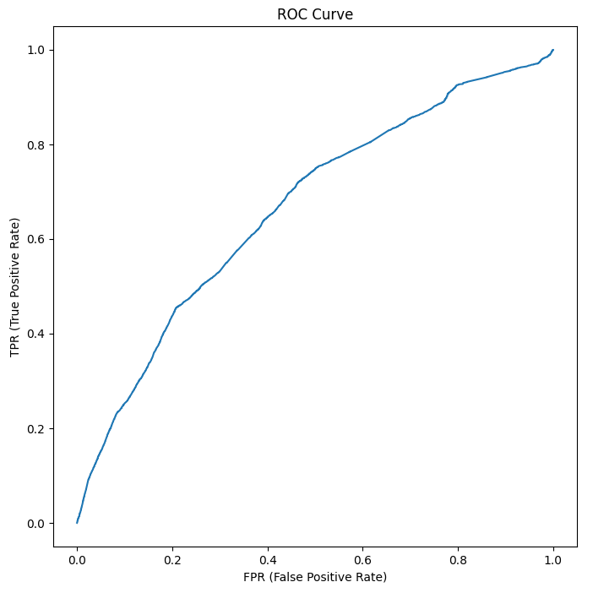
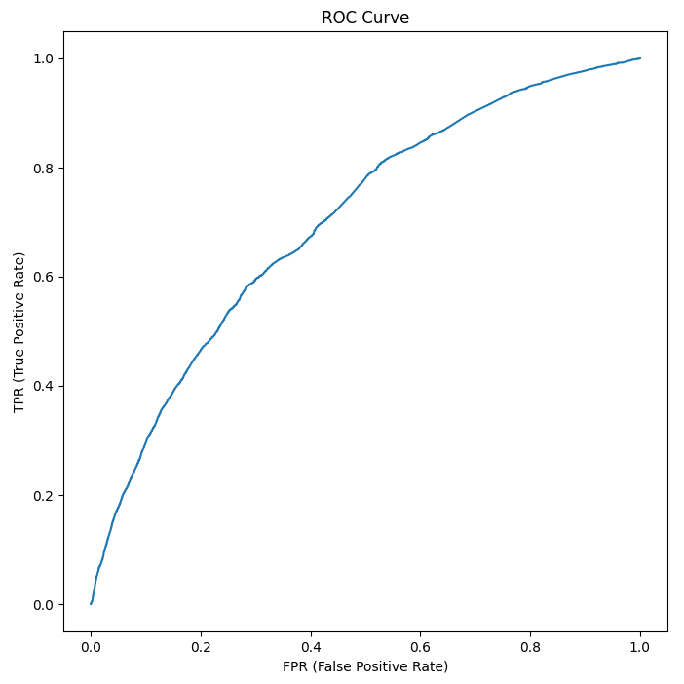

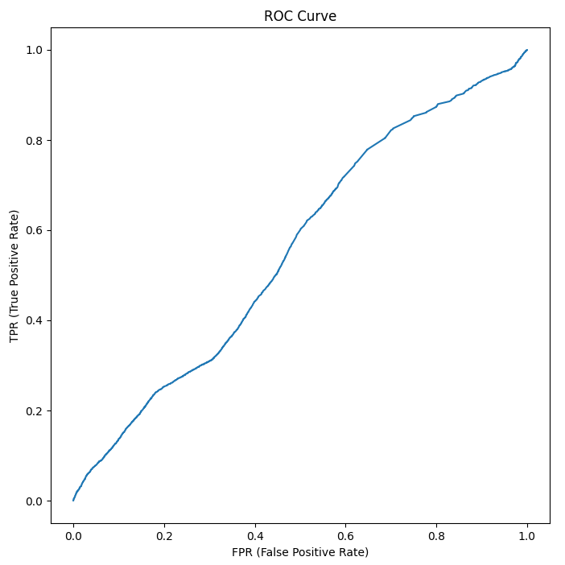

Correlation Based Feature Selection
F Score Feature Selection
Forward Sequential Feature Selection
Recursive Feature Selection
Select from Model Feature Selection

Slide 26
Decision Tree – SMOTE
Feature Selection | Class | Accuracy | TPR | FPR | Precision | Recall | F1 Score | MCC | ROC
Correlation based feature selection | Heart Attack = 1 | 0.327321673 | 0.305250414 | 0.694749586 | 0.948860002 | 0.305250414 | 0.400174037 | 0.004793428 | 0.504230474
 | Heart Attack = 2 | 0.327321673 | 0.703218762 | 0.296781238 | 0.054155784 | 0.703218762 | 0.099439713 | 0.004793428 | 0.504230474
 | Weighted | 0.327321673 | 0.327321673 | 0.672678327 | 0.899791389 | 0.327321673 | 0.383813658 | 0.004793428 | 0.504230474
F Score feature selection | Heart Attack = 1 | 0.429919534 | 0.427920142 | 0.572079858 | 0.930220056 | 0.427920142 | 0.57640923 | -0.050797608 | 0.446463024
 | Heart Attack = 2 | 0.429919534 | 0.465307847 | 0.534692153 | 0.045590604 | 0.465307847 | 0.082672478 | -0.050797608 | 0.446463024
 | Weighted | 0.429919534 | 0.429919534 | 0.570080466 | 0.881704639 | 0.429919534 | 0.549306752 | -0.050797608 | 0.446463024
Forward Sequential Feature Selection | Heart Attack = 1 | 0.528092499 | 0.533295031 | 0.466704969 | 0.937497783 | 0.533295031 | 0.658013549 | -0.015043831 | 0.486272887
 | Heart Attack = 2 | 0.528092499 | 0.439120875 | 0.560879125 | 0.054244103 | 0.439120875 | 0.09506401 | -0.015043831 | 0.486272887
 | Weighted | 0.528092499 | 0.528092499 | 0.471907501 | 0.889053806 | 0.528092499 | 0.627100404 | -0.015043831 | 0.486272887
Recursive Feature Elimination | Heart Attack = 1 | 0.451274658 | 0.443705899 | 0.556294101 | 0.933524525 | 0.443705899 | 0.561061427 | 0.006325978 | 0.514042861
 | Heart Attack = 2 | 0.451274658 | 0.583836127 | 0.416163873 | 0.059204522 | 0.583836127 | 0.106316954 | 0.006325978 | 0.514042861
 | Weighted | 0.451274658 | 0.451274658 | 0.548725342 | 0.885563456 | 0.451274658 | 0.53603736 | 0.006325978 | 0.514042861
Select from Model | Heart Attack = 1 | 0.463094485 | 0.45480204 | 0.54519796 | 0.951618537 | 0.45480204 | 0.593006675 | 0.030341864 | 0.53129727
 | Heart Attack = 2 | 0.463094485 | 0.607772787 | 0.392227213 | 0.063128287 | 0.607772787 | 0.113216569 | 0.030341864 | 0.53129727
 | Weighted | 0.463094485 | 0.463094485 | 0.536905515 | 0.902892084 | 0.463094485 | 0.56665121 | 0.030341864 | 0.53129727

Slide 27
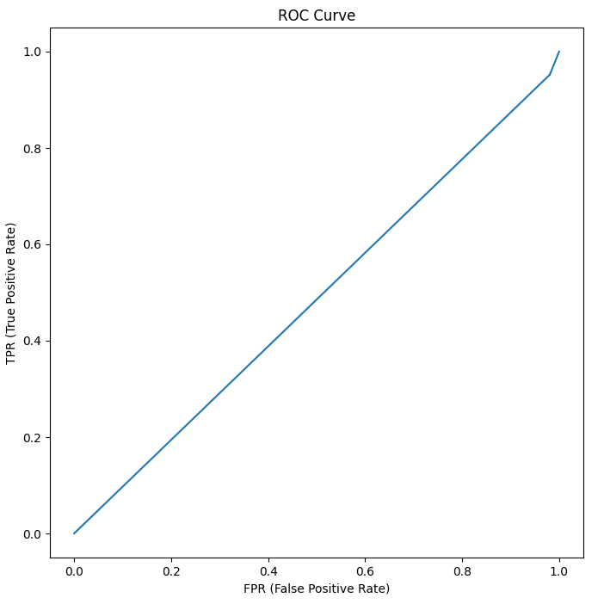
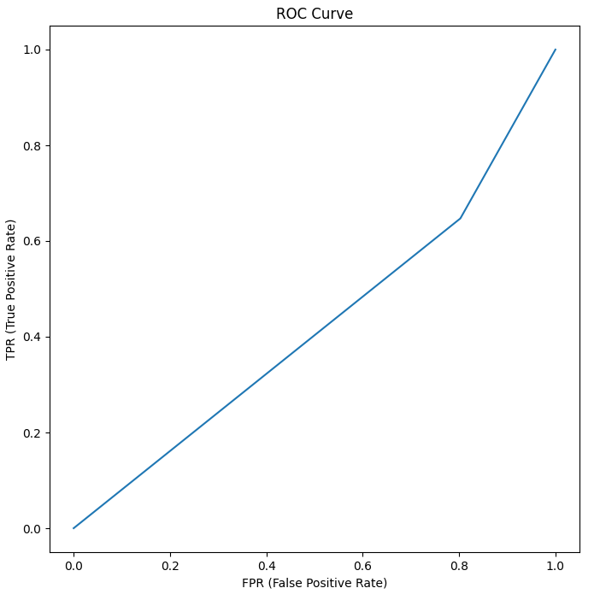
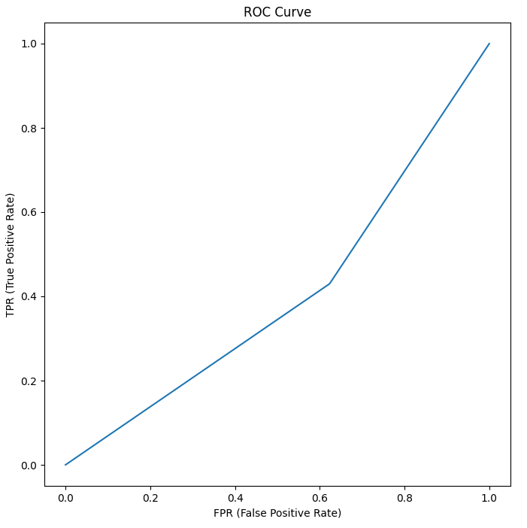

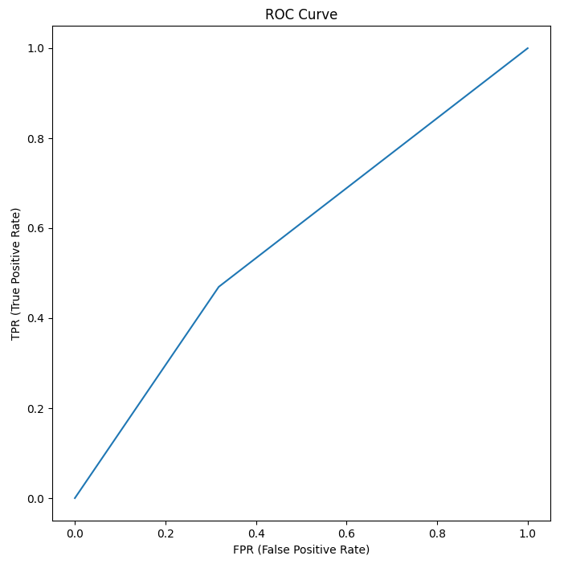
Correlation Based Feature Selection
F Score Feature Selection
Forward Sequential Feature Selection
Recursive Feature Selection
Select from Model Feature Selection

Slide 28
Logistic Regression – SMOTE
Feature Selection | Class | Accuracy | TPR | FPR | Precision | Recall | F1 Score | MCC | ROC
Correlation based feature selection | Heart Attack = 1 | 0.939925565 | 0.993660139 | 0.006339861 | 0.945552382 | 0.993660139 | 0.969006476 | 0.020211067 | 0.555098065
 | Heart Attack = 2 | 0.939925565 | 0.013902739 | 0.986097261 | 0.112105045 | 0.013902739 | 0.024199227 | 0.020211067 | 0.555098065
 | Weighted | 0.939925565 | 0.939925565 | 0.060074435 | 0.899846398 | 0.939925565 | 0.917188268 | 0.020211067 | 0.555098065
F Score feature selection | Heart Attack = 1 | 0.92568146 | 0.975048673 | 0.024951327 | 0.947818235 | 0.975048673 | 0.961240309 | 0.069293863 | 0.625568559
 | Heart Attack = 2 | 0.92568146 | 0.074835996 | 0.925164004 | 0.148487005 | 0.074835996 | 0.099468677 | 0.069293863 | 0.625568559
 | Weighted | 0.92568146 | 0.92568146 | 0.07431854 | 0.903982558 | 0.92568146 | 0.913981198 | 0.069293863 | 0.625568559
Forward Sequential Feature Selection | Heart Attack = 1 | 0.930821283 | 0.980358199 | 0.019641801 | 0.948203107 | 0.980358199 | 0.964010279 | 0.087814234 | 0.689557136
 | Heart Attack = 2 | 0.930821283 | 0.07699684 | 0.92300316 | 0.186903503 | 0.07699684 | 0.108602659 | 0.087814234 | 0.689557136
 | Weighted | 0.930821283 | 0.930821283 | 0.069178717 | 0.906449559 | 0.930821283 | 0.917102204 | 0.087814234 | 0.689557136
Recursive Feature Elimination | Heart Attack = 1 | 0.924169229 | 0.973034647 | 0.026965353 | 0.94809654 | 0.973034647 | 0.960392896 | 0.07304206 | 0.655215776
 | Heart Attack = 2 | 0.924169229 | 0.081769912 | 0.918230088 | 0.150837778 | 0.081769912 | 0.104565068 | 0.07304206 | 0.655215776
 | Weighted | 0.924169229 | 0.924169229 | 0.075830771 | 0.904372082 | 0.924169229 | 0.913468204 | 0.07304206 | 0.655215776
Select from Model | Heart Attack = 1 | 0.891469424 | 0.928317529 | 0.071682471 | 0.95563816 | 0.928317529 | 0.941629602 | 0.153130997 | 0.72649508
 | Heart Attack = 2 | 0.891469424 | 0.255907016 | 0.744092984 | 0.17385881 | 0.255907016 | 0.202943629 | 0.153130997 | 0.72649508
 | Weighted | 0.891469424 | 0.891469424 | 0.108530576 | 0.91276306 | 0.891469424 | 0.901130137 | 0.153130997 | 0.72649508

Slide 29
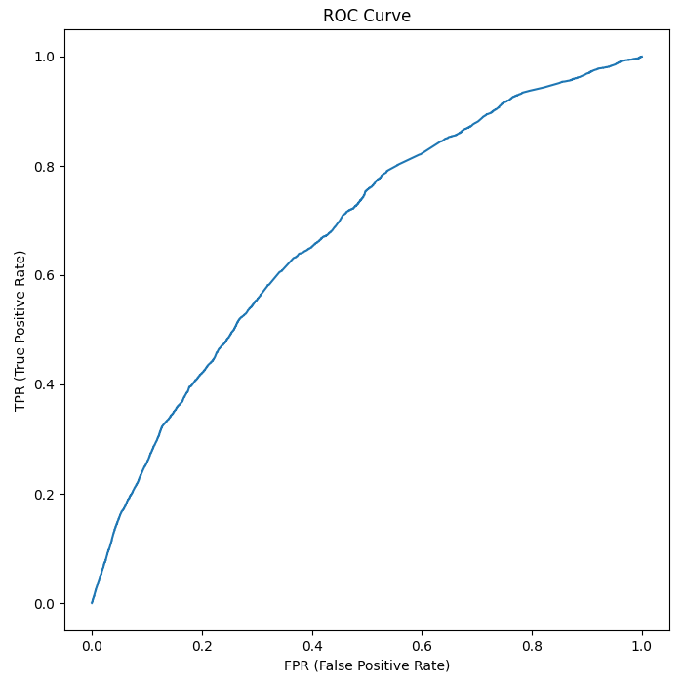


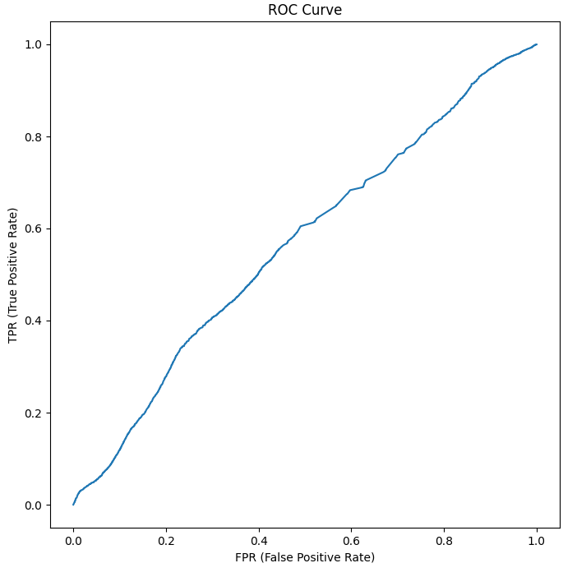
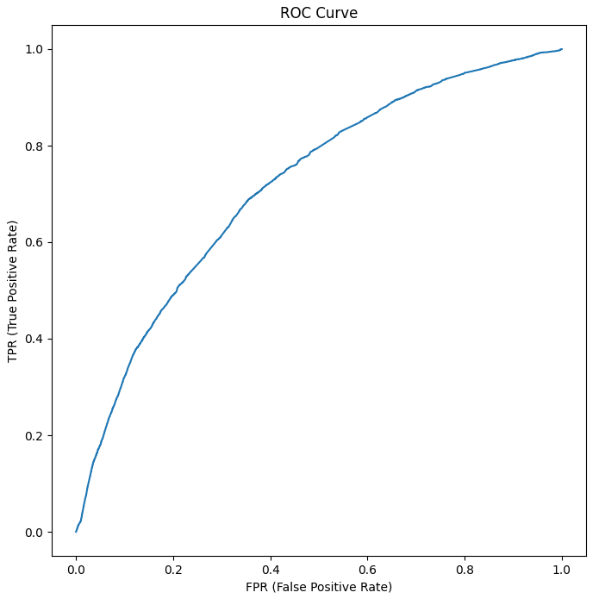
Correlation Based Feature Selection
F Score Feature Selection
Forward Sequential Feature Selection
Recursive Feature Selection
Select from Model Feature Selection

Slide 30
Gaussian Naïve Bayesian – SMOTE
Feature Selection | Class | Accuracy | TPR | FPR | Precision | Recall | F1 Score | MCC | ROC
Correlation based feature selection | Heart Attack = 1 | 0.593221436 | 0.597961847 | 0.402038153 | 0.955939566 | 0.597961847 | 0.698236374 | 0.059092199 | 0.588311161
 | Heart Attack = 2 | 0.593221436 | 0.508529906 | 0.491470094 | 0.076929565 | 0.508529906 | 0.127456164 | 0.059092199 | 0.588311161
 | Weighted | 0.593221436 | 0.593221436 | 0.406778564 | 0.907725877 | 0.593221436 | 0.667002642 | 0.059092199 | 0.588311161
F Score feature selection | Heart Attack = 1 | 0.850155195 | 0.89339052 | 0.10660948 | 0.945064536 | 0.89339052 | 0.918501163 | -0.001179156 | 0.501235911
 | Heart Attack = 2 | 0.850155195 | 0.105010211 | 0.894989789 | 0.05406605 | 0.105010211 | 0.071379539 | -0.001179156 | 0.501235911
 | Weighted | 0.850155195 | 0.850155195 | 0.149844805 | 0.896201432 | 0.850155195 | 0.872044426 | -0.001179156 | 0.501235911
Forward Sequential Feature Selection | Heart Attack = 1 | 0.934903426 | 0.988040617 | 0.011959383 | 0.945534841 | 0.988040617 | 0.966315006 | 0.014756836 | 0.589052123
 | Heart Attack = 2 | 0.934903426 | 0.019153443 | 0.980846557 | 0.086149322 | 0.019153443 | 0.030615629 | 0.014756836 | 0.589052123
 | Weighted | 0.934903426 | 0.934903426 | 0.065096574 | 0.898399865 | 0.934903426 | 0.914997838 | 0.014756836 | 0.589052123
Recursive Feature Elimination | Heart Attack = 1 | 0.87457303 | 0.920822836 | 0.079177164 | 0.945052032 | 0.920822836 | 0.932763005 | -0.001346887 | 0.584556073
 | Heart Attack = 2 | 0.87457303 | 0.077359496 | 0.922640504 | 0.053979697 | 0.077359496 | 0.063410847 | -0.001346887 | 0.584556073
 | Weighted | 0.87457303 | 0.87457303 | 0.12542697 | 0.896183985 | 0.87457303 | 0.885089343 | -0.001346887 | 0.584556073
Select from Model | Heart Attack = 1 | 0.87457303 | 0.920822836 | 0.079177164 | 0.945052032 | 0.920822836 | 0.932763005 | -0.001346887 | 0.584556073
 | Heart Attack = 2 | 0.87457303 | 0.077359496 | 0.922640504 | 0.053979697 | 0.077359496 | 0.063410847 | -0.001346887 | 0.584556073
 | Weighted | 0.87457303 | 0.87457303 | 0.12542697 | 0.896183985 | 0.87457303 | 0.885089343 | -0.001346887 | 0.584556073

Slide 31
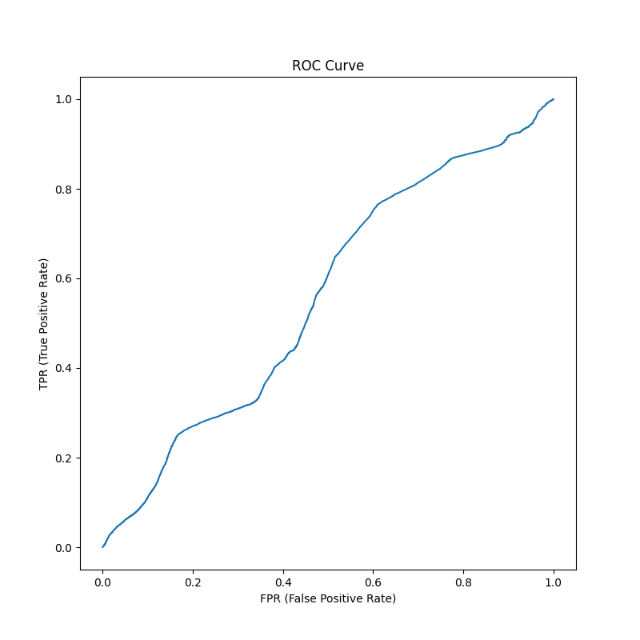

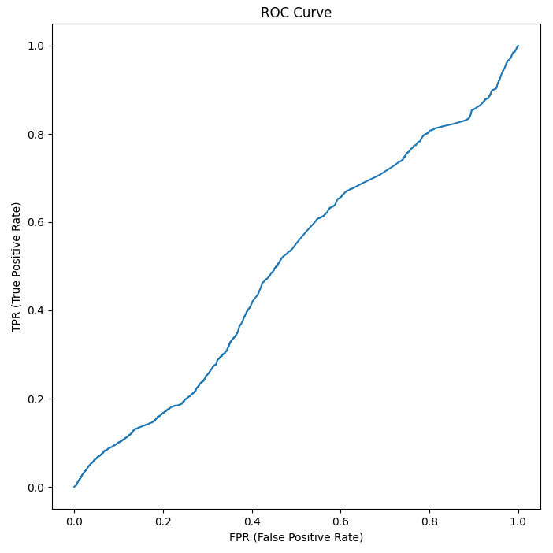
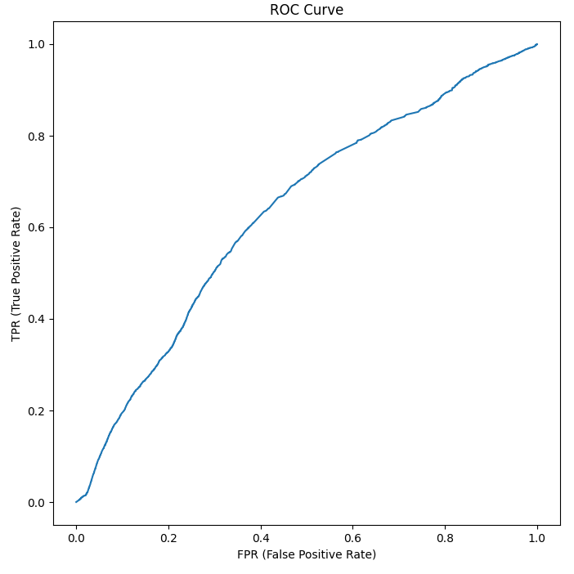
Correlation Based Feature Selection
F Score Feature Selection
Forward Sequential Feature Selection
Recursive Feature Selection
Select from Model Feature Selection

Slide 32
Random Forest – SMOTE
Feature Selection | Class | Accuracy | TPR | FPR | Precision | Recall | F1 Score | MCC | ROC
Correlation based feature selection | Heart Attack = 1 | 0.49936451 | 0.498902735 | 0.501097265 | 0.944821975 | 0.498902735 | 0.643547883 | 0.004891152 | 0.502739416
 | Heart Attack = 2 | 0.49936451 | 0.507213641 | 0.492786359 | 0.058497443 | 0.507213641 | 0.103590408 | 0.004891152 | 0.502739416
 | Weighted | 0.49936451 | 0.49936451 | 0.50063549 | 0.89621531 | 0.49936451 | 0.613947283 | 0.004891152 | 0.502739416
F Score feature selection | Heart Attack = 1 | 0.727112785 | 0.757211373 | 0.242788627 | 0.942079646 | 0.757211373 | 0.830697443 | -0.016554567 | 0.478281542
 | Heart Attack = 2 | 0.727112785 | 0.20786423 | 0.79213577 | 0.050379653 | 0.20786423 | 0.075889555 | -0.016554567 | 0.478281542
 | Weighted | 0.727112785 | 0.727112785 | 0.272887215 | 0.893183917 | 0.727112785 | 0.78931956 | -0.016554567 | 0.478281542
Forward Sequential Feature Selection | Heart Attack = 1 | 0.7371806 | 0.76359033 | 0.23640967 | 0.94923014 | 0.76359033 | 0.835047959 | 0.025591626 | 0.543785335
 | Heart Attack = 2 | 0.7371806 | 0.280669931 | 0.719330069 | 0.066402759 | 0.280669931 | 0.10044698 | 0.025591626 | 0.543785335
 | Weighted | 0.7371806 | 0.7371806 | 0.2628194 | 0.90082409 | 0.7371806 | 0.794793721 | 0.025591626 | 0.543785335
Recursive Feature Elimination | Heart Attack = 1 | 0.559458068 | 0.565114091 | 0.434885909 | 0.937900204 | 0.565114091 | 0.647639433 | 0.012350493 | 0.541127136
 | Heart Attack = 2 | 0.559458068 | 0.467077242 | 0.532922758 | 0.060961525 | 0.467077242 | 0.103535007 | 0.012350493 | 0.541127136
 | Weighted | 0.559458068 | 0.559458068 | 0.440541932 | 0.889799699 | 0.559458068 | 0.61764464 | 0.012350493 | 0.541127136
Select from Model | Heart Attack = 1 | 0.740769944 | 0.763996558 | 0.236003442 | 0.952375335 | 0.763996558 | 0.847600244 | 0.054819755 | 0.586494884
 | Heart Attack = 2 | 0.740769944 | 0.340011244 | 0.659988756 | 0.076554944 | 0.340011244 | 0.124782534 | 0.054819755 | 0.586494884
 | Weighted | 0.740769944 | 0.740769944 | 0.259230056 | 0.904343254 | 0.740769944 | 0.807967736 | 0.054819755 | 0.586494884

Slide 33
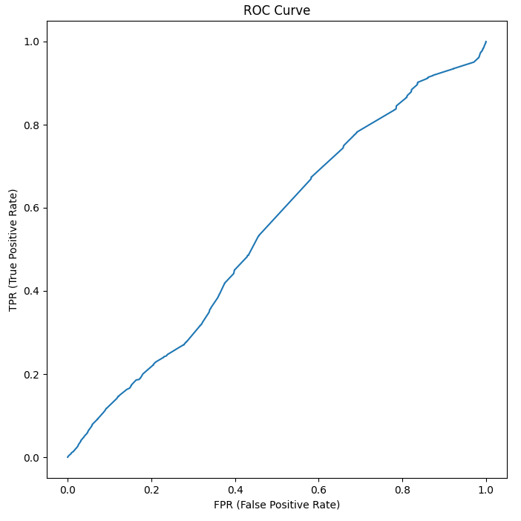
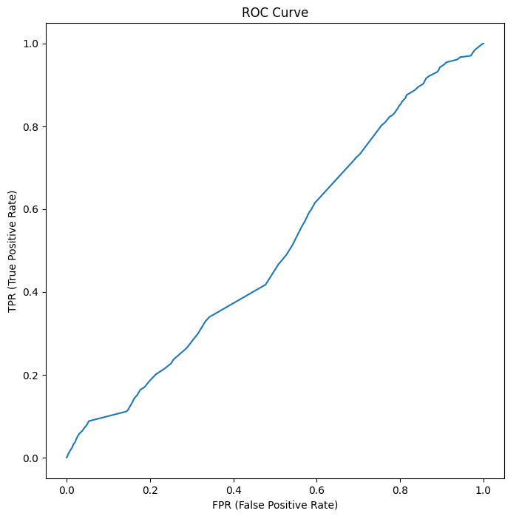
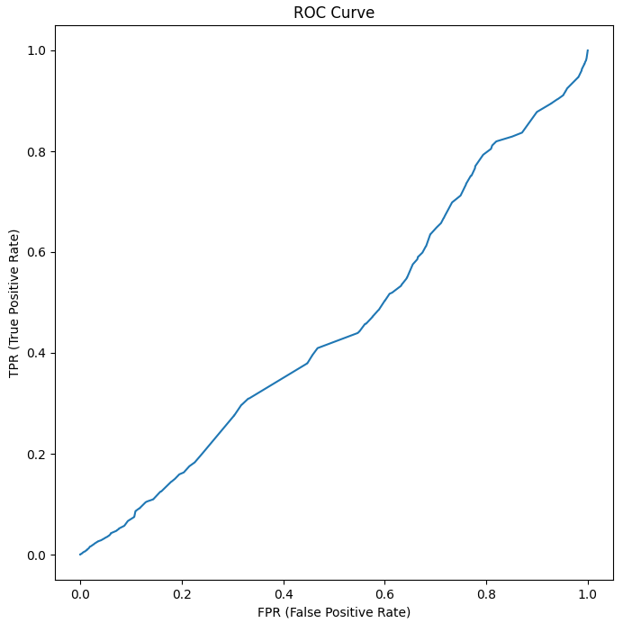
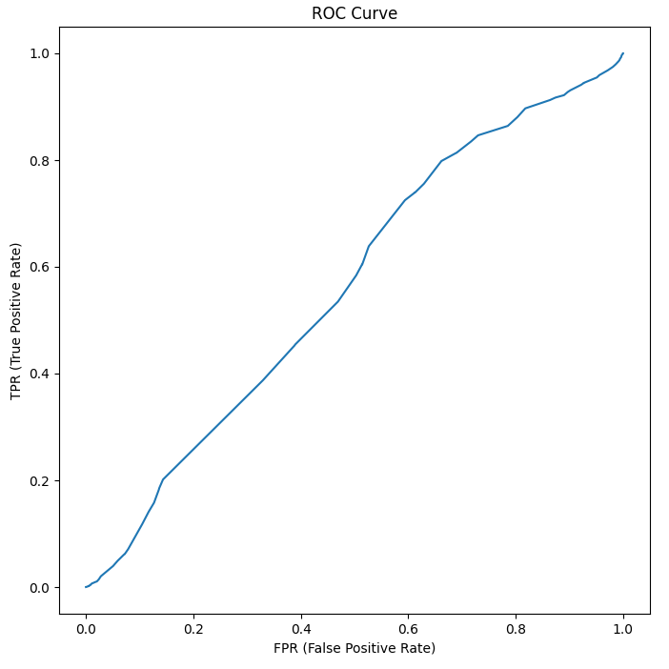
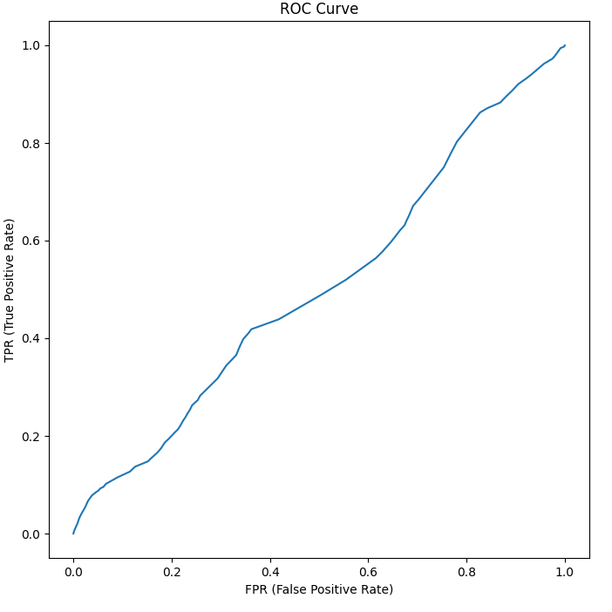
Correlation Based Feature Selection
F Score Feature Selection
Forward Sequential Feature Selection
Recursive Feature Selection
Select from Model Feature Selection

Slide 34
Best Model – SMOTE
Classifier | Feature Selection | Class | Accuracy | TPR | FPR | Precision | Recall | F1 Score | MCC | ROC
Ada Boost | Select from Model | Heart Attack = 1 | 0.915259124 | 0.961845377 | 0.038154623 | 0.949270616 | 0.961845377 | 0.955267138 | 0.076989577 | 0.702672513
 |  | Heart Attack = 2 | 0.915259124 | 0.112024146 | 0.887975854 | 0.141530531 | 0.112024146 | 0.109501674 | 0.076989577 | 0.702672513
 |  | Weighted | 0.915259124 | 0.915259124 | 0.084740876 | 0.904972904 | 0.915259124 | 0.908893848 | 0.076989577 | 0.702672513
Decision Tree | Select from Model | Heart Attack = 1 | 0.463094485 | 0.45480204 | 0.54519796 | 0.951618537 | 0.45480204 | 0.593006675 | 0.030341864 | 0.53129727
 |  | Heart Attack = 2 | 0.463094485 | 0.607772787 | 0.392227213 | 0.063128287 | 0.607772787 | 0.113216569 | 0.030341864 | 0.53129727
 |  | Weighted | 0.463094485 | 0.463094485 | 0.536905515 | 0.902892084 | 0.463094485 | 0.56665121 | 0.030341864 | 0.53129727
Logistic Regression | Select from Model | Heart Attack = 1 | 0.891469424 | 0.928317529 | 0.071682471 | 0.95563816 | 0.928317529 | 0.941629602 | 0.153130997 | 0.72649508
 |  | Heart Attack = 2 | 0.891469424 | 0.255907016 | 0.744092984 | 0.17385881 | 0.255907016 | 0.202943629 | 0.153130997 | 0.72649508
 |  | Weighted | 0.891469424 | 0.891469424 | 0.108530576 | 0.91276306 | 0.891469424 | 0.901130137 | 0.153130997 | 0.72649508
Gaussian Naïve Bayesian | Forward Sequential Feature Selection | Heart Attack = 1 | 0.934903426 | 0.988040617 | 0.011959383 | 0.945534841 | 0.988040617 | 0.966315006 | 0.014756836 | 0.589052123
 |  | Heart Attack = 2 | 0.934903426 | 0.019153443 | 0.980846557 | 0.086149322 | 0.019153443 | 0.030615629 | 0.014756836 | 0.589052123
 |  | Weighted | 0.934903426 | 0.934903426 | 0.065096574 | 0.898399865 | 0.934903426 | 0.914997838 | 0.014756836 | 0.589052123
Random Forest | Select from Model | Heart Attack = 1 | 0.740769944 | 0.763996558 | 0.236003442 | 0.952375335 | 0.763996558 | 0.847600244 | 0.054819755 | 0.586494884
 |  | Heart Attack = 2 | 0.740769944 | 0.340011244 | 0.659988756 | 0.076554944 | 0.340011244 | 0.124782534 | 0.054819755 | 0.586494884
 |  | Weighted | 0.740769944 | 0.740769944 | 0.259230056 | 0.904343254 | 0.740769944 | 0.807967736 | 0.054819755 | 0.586494884

Slide 35
Conclusion
Data Preparation
Data Set Balancing
Feature Selection
Classification
Different methods give different results.

